Slide 1
SESA – Website
Attachment to the ToR

Slide 2
Information Structure
SESA Homepage
About us
Services and Programs
Programs
Public Information
FAQ
WorkNet
Services
Legal Information
Public Information
Contact
Hierarchy Level 1 – 1 Side
Hierarchy Level 2 – 6 Sides
Hierarchy Level 3 – 4 Sides
In total:
11 Slides

Slide 3
Homepage – Hierarchy Level 1

Slide 4
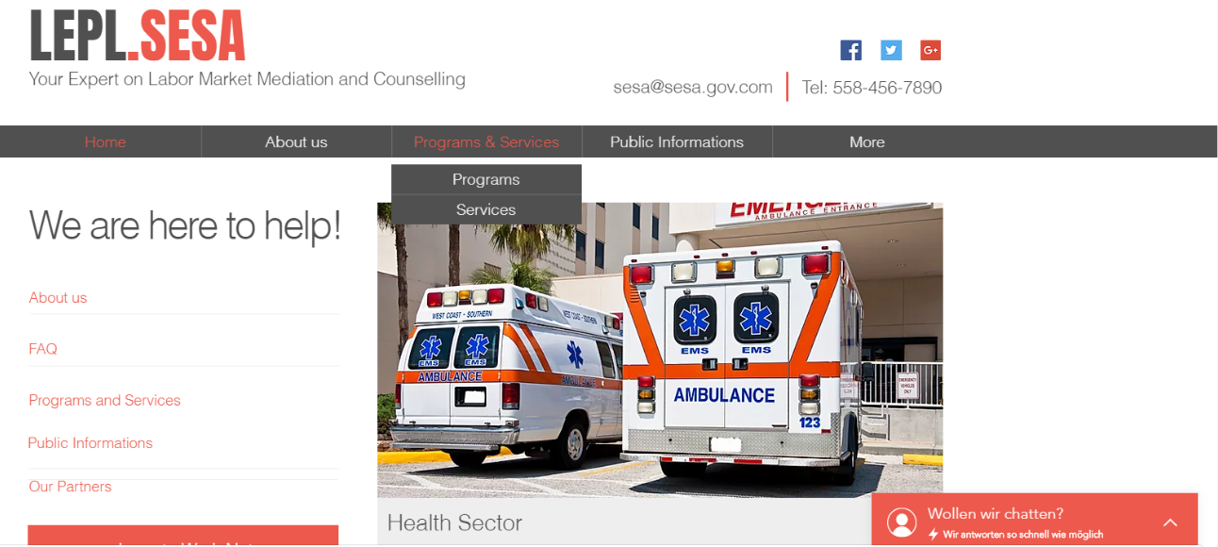


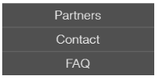


Header
Top Navigation
Top Navigation
Folding Menu Bar
Margin
Navigation
Body
Hierarchy Level 1
Moving Pictures
Live Chat

Slide 5
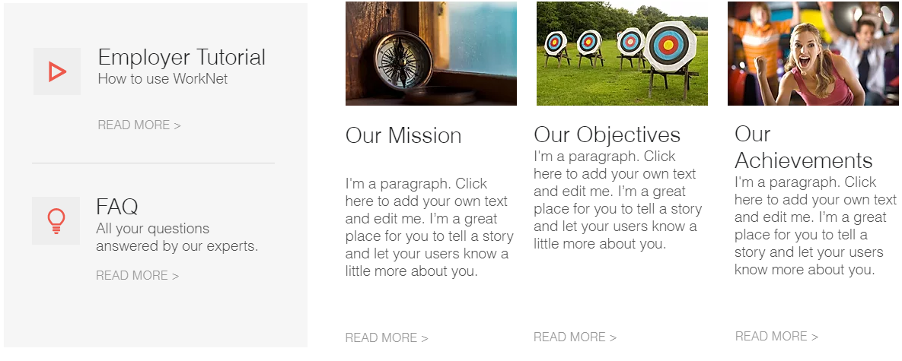


Body
Jump to Hierachy Level 2
Jump to Hierachy Level 2
Jump to Hierachy Level 2
Hierarchy Level 1
Push the Picture and you land at the Website of the Partner Hierarchy Level 2

Slide 6









Body
Hierarchy Level 1
Jump to Hierachy Level 2
Push the Picture and you land at the Website of the Partner Hierarchy Level 2

Slide 7
Body
Hierarchy Level 1
Push the LOGO and you land at the Website of the Partner Hierarchy Level 2

Slide 8






Body
Hierarchy Level 1
Push the LOGO and you land at the Website of the Partner Hierarchy Level 2

Slide 9
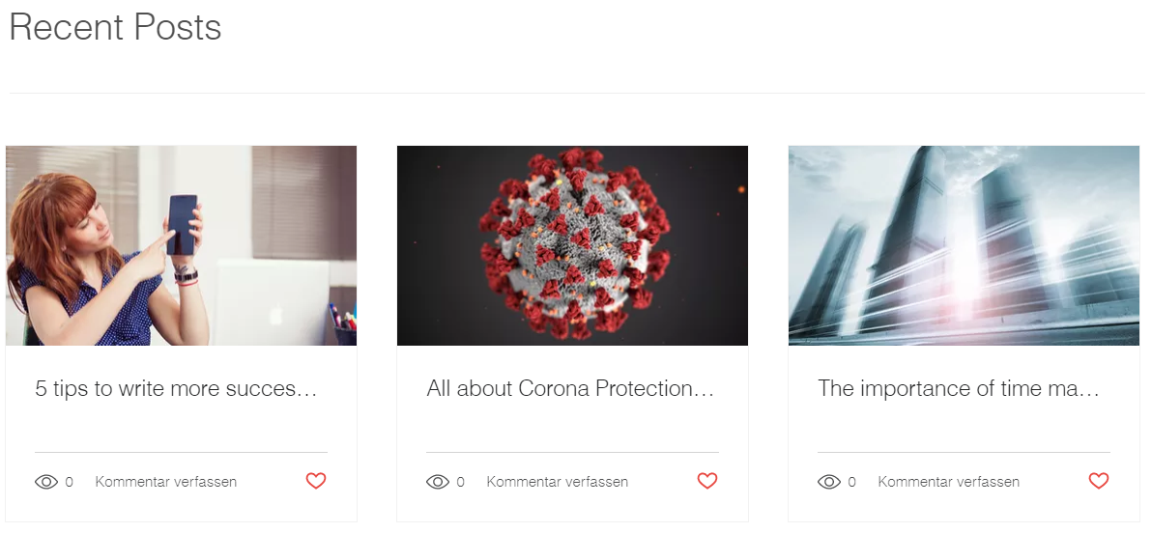

Body
Hierarchy Level 1
Push and jump to the Content – Hierarchy Level 2
Footer
Sitemap
Push and jump to the Content – Hierarchy Level 2

Slide 10
About us – Hierarchy Level 2

Slide 11

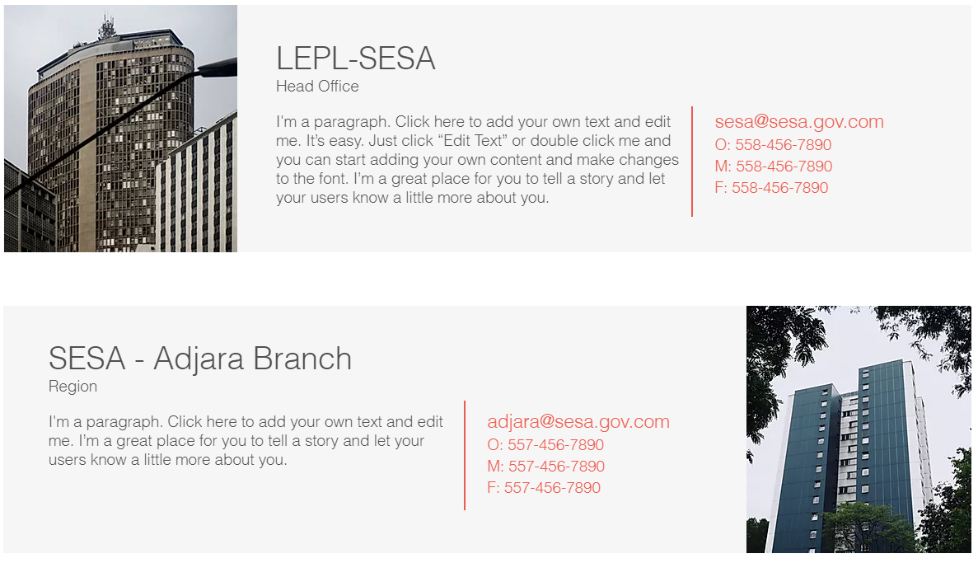
About us
Body
Scroll down to see more offices
Hierarchy Level 2
A Picture of each branch gets presented

Slide 12
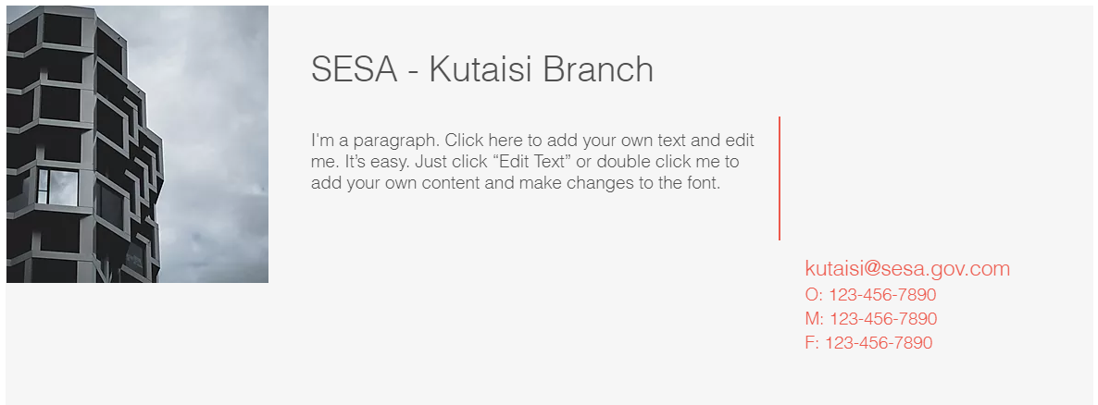
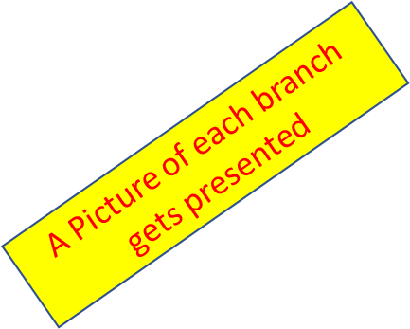
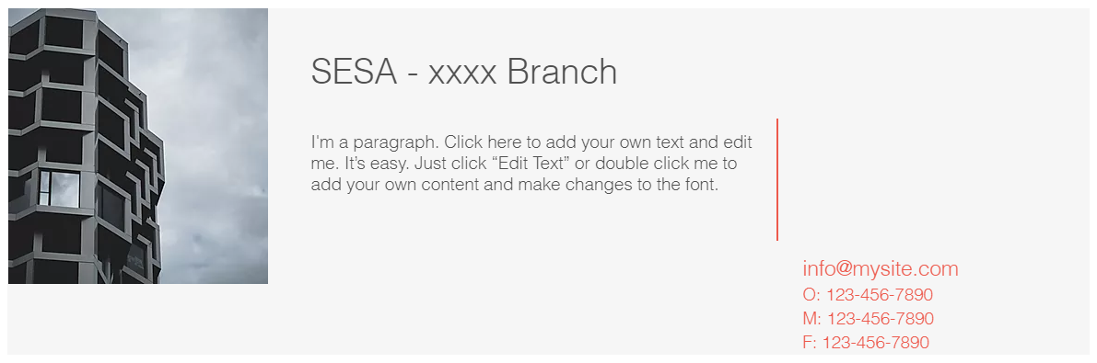
About us
Body
Hierarchy Level 2

Slide 13
Programs and Services – Hierarchy Level 2

Slide 14
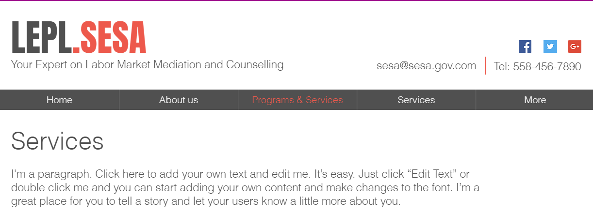


Programs and Services
Body
Programs and Services
Hierarchy Level 2
Read more…

Slide 15
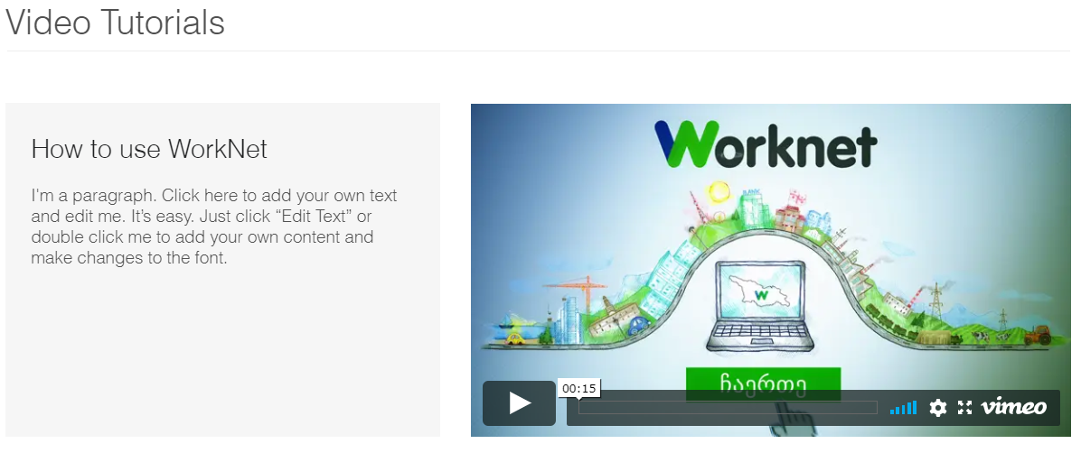
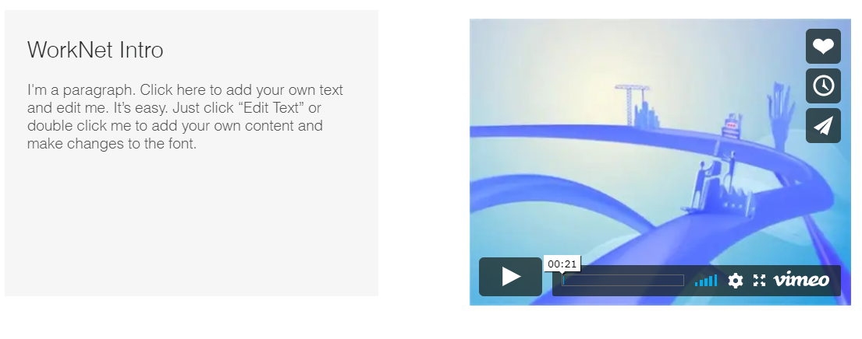
Programs and Services
Scroll Down to the next Tutorial
Body
Hierarchy Level 2

Slide 16
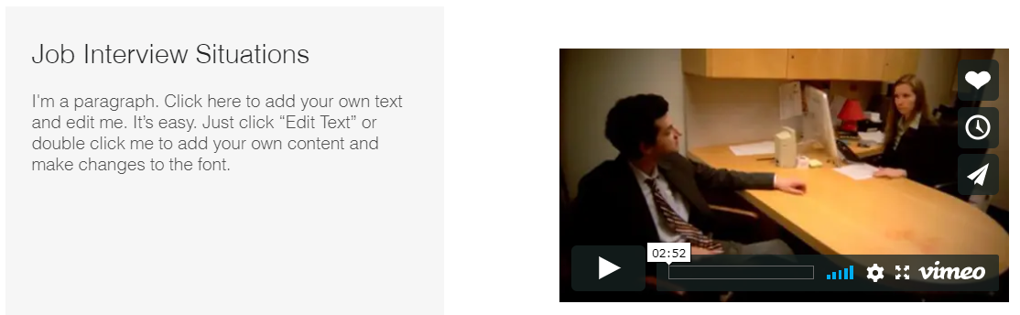
Programs and Services
Body
Hierarchy Level 2

Slide 17
Services – Hierarchy Level 3

Slide 18
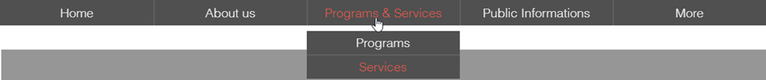


Services
Body
Hierarchy Level 3

Slide 19
Programs – Hierarchy Level 3

Slide 20
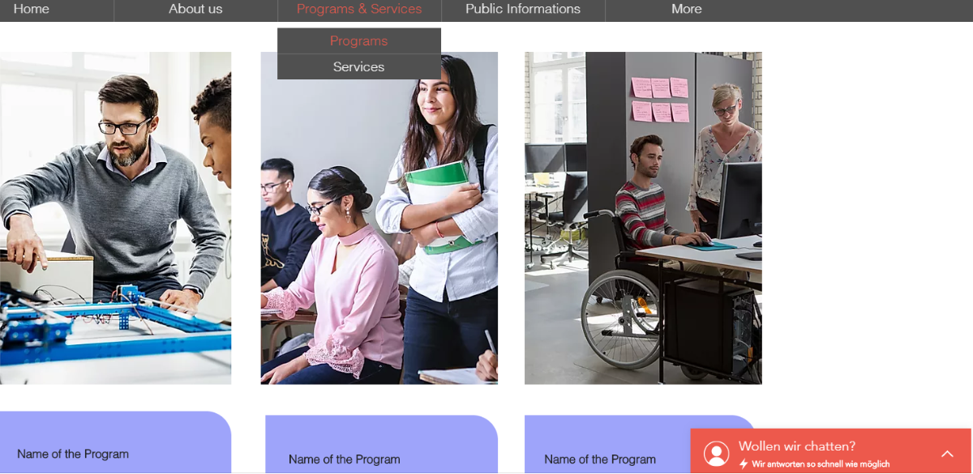
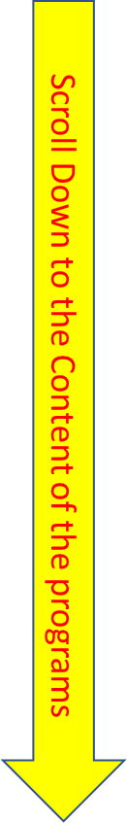
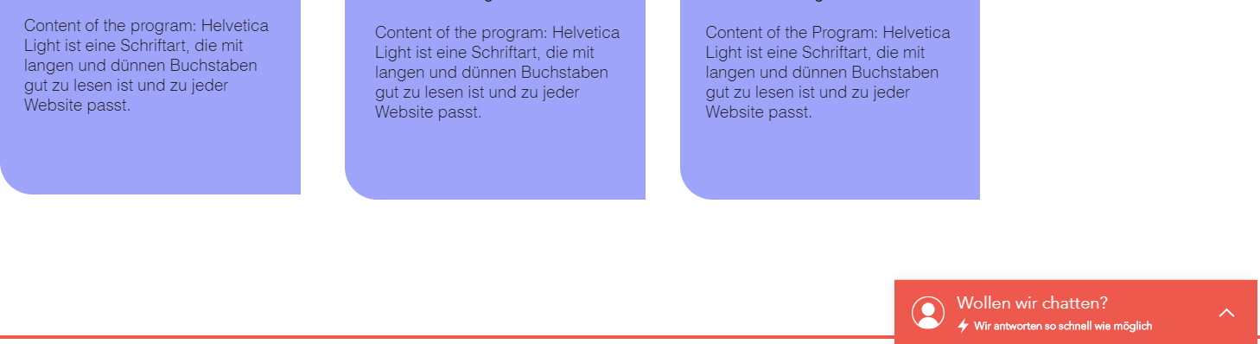
Programs
Body
Mouse-Over functionality
Hierarchy Level 3

Slide 21

Programs
Body
Hierarchy Level 3
Mouse – Over View

Slide 22
Public Information – Hierarchy Level 2

Slide 23
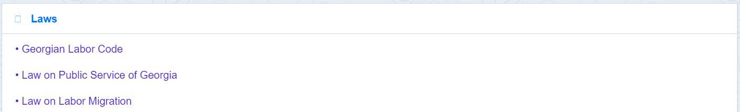
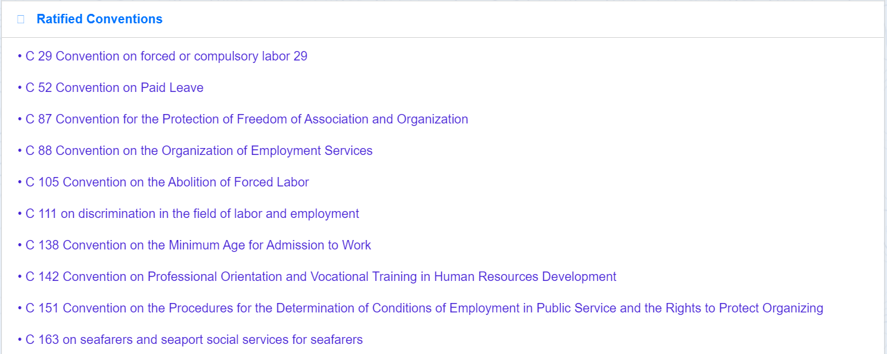
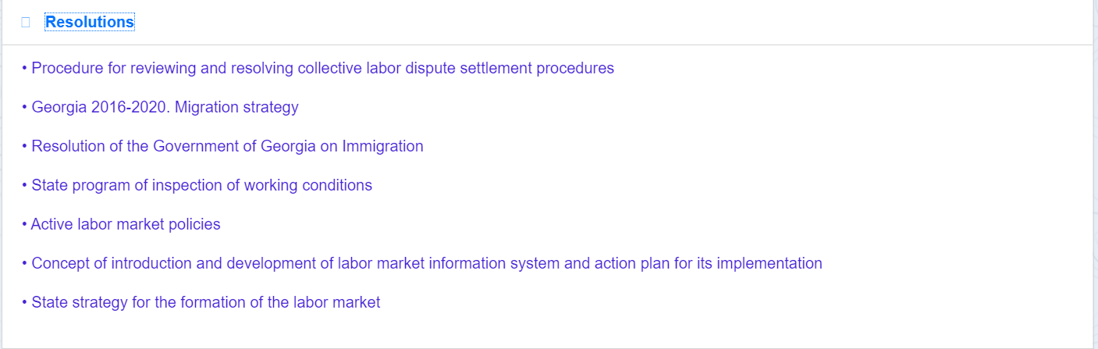
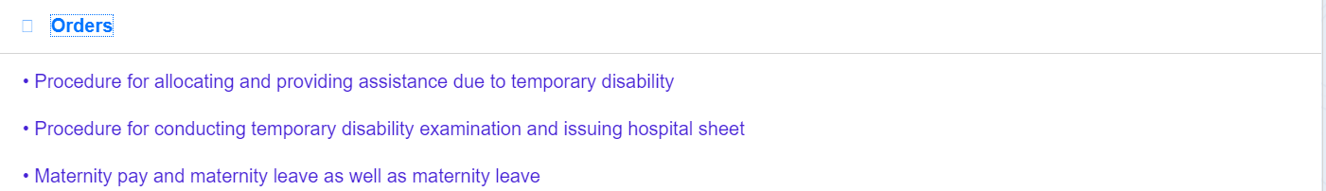
Public Informations
Legal Information
Hierarchy Level 2
Body

Slide 24
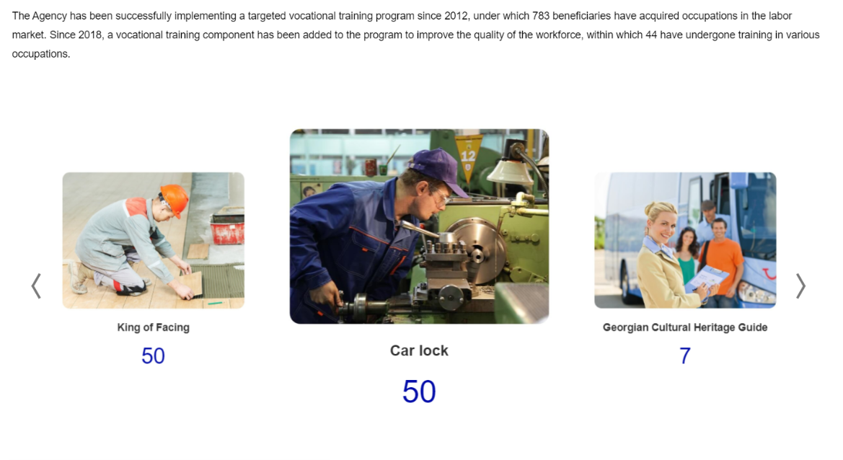
Public Informations
Public Information
Kind and Number of promoted vocational trainings
Hierarchy Level 2
Body
Slider
Slider

Slide 25
FAQ – Hierarchy Level 2

Slide 26
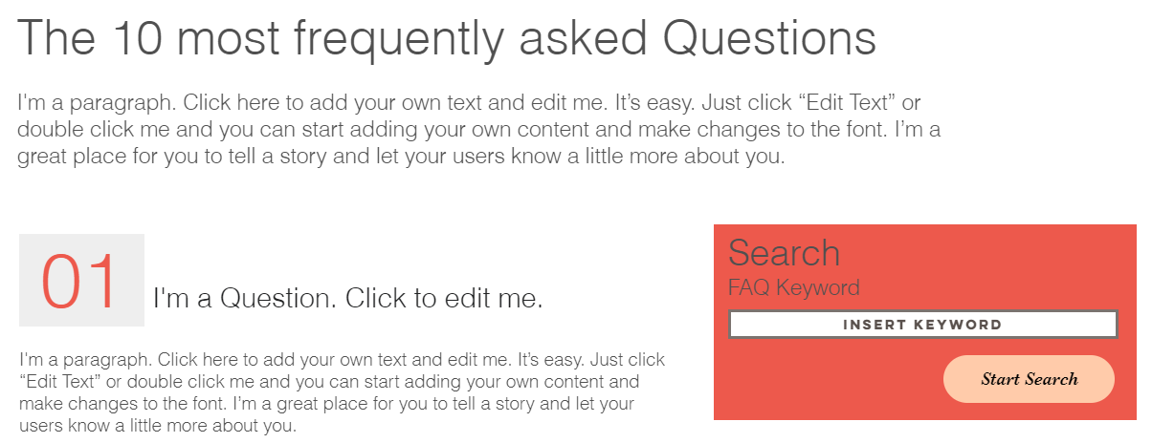
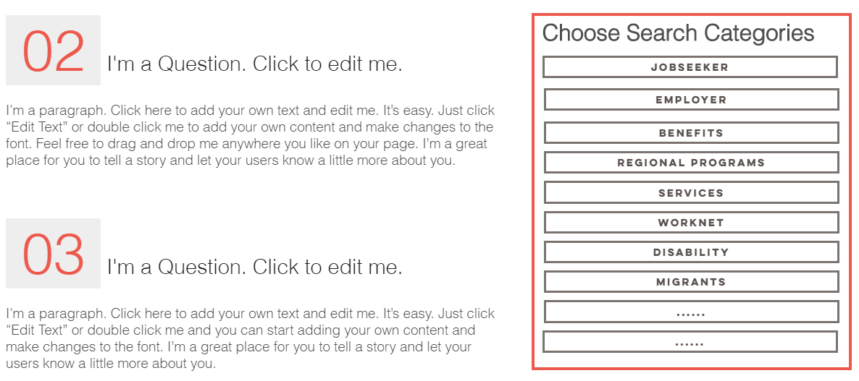
FAQ
Scroll to the end of the website to reach question 10
Hierarchy Level 2
Search function
Body
Accordion Functionality
Press the category Jobseeker and you will see all the questions belonging to that category.

Slide 27
Contact – Hierarchy Level 2

Slide 28
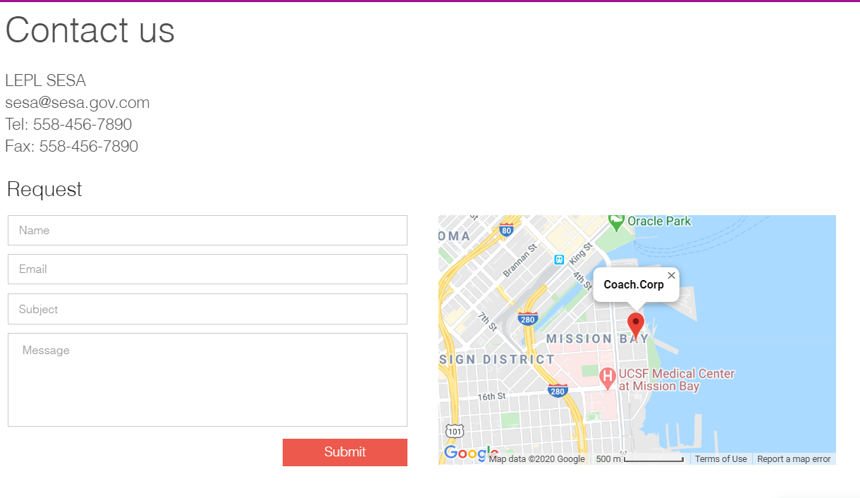
Contact
Hierarchy Level 2
Body

